Slide 1
B9DA106 DATA VISUALIZATION
PRACTICAL ASSIGNMENT – TABLEAU

Slide 2

VISUALIZATION BY TABLEAU

Slide 3
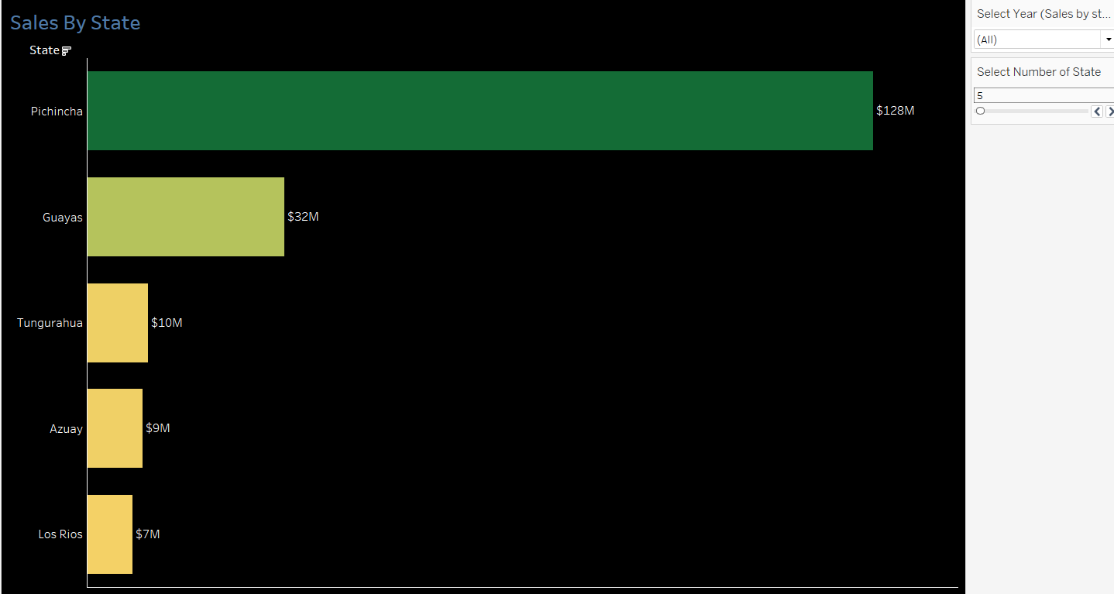
1. STORE COUNT AND TOTAL SALES BY STATE

Slide 4
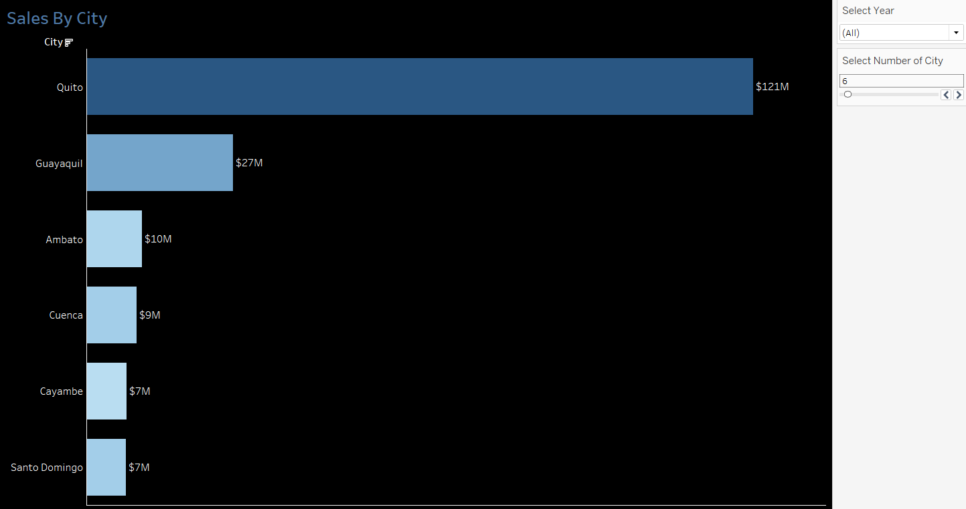
2. STORE COUNT AND TOTAL SALES BY CITY

Slide 5
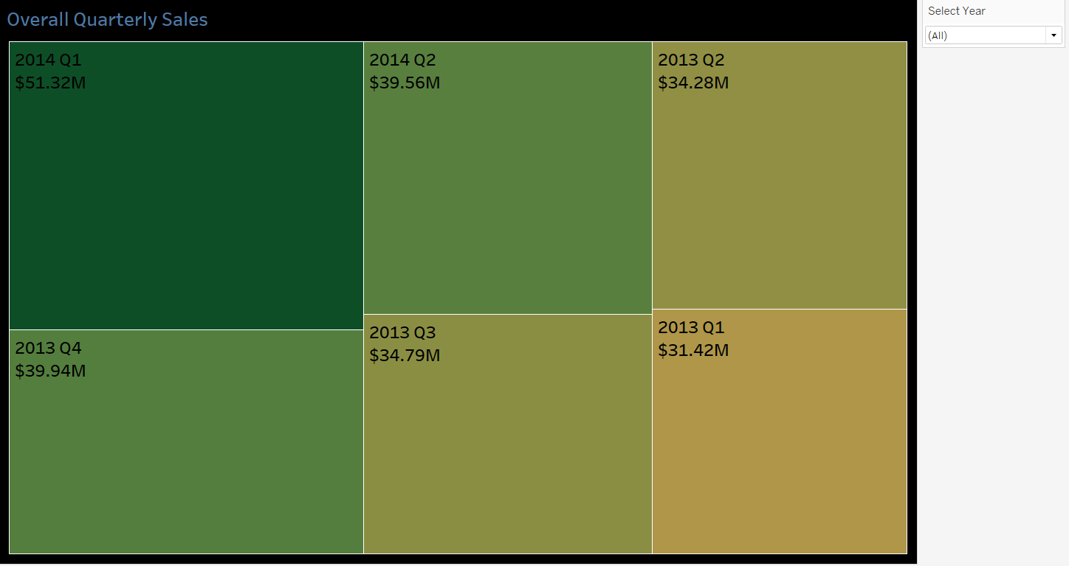
3. OVERALL TOTAL QUARTERLY SALES

Slide 6
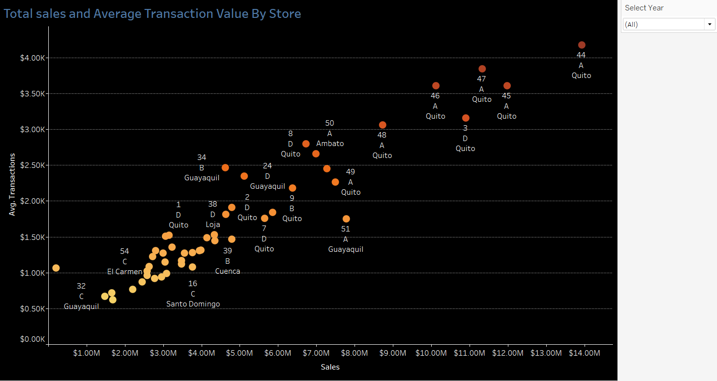
4. TOTAL SALES AND AVERAGE TRANSACTION VALUE BY STORE

Slide 7
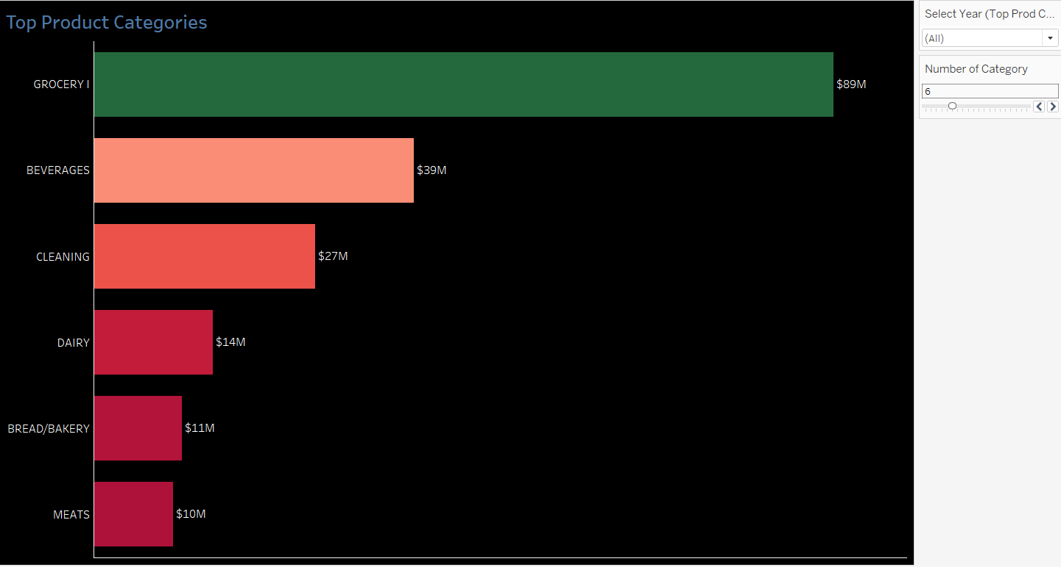
5. TOP PRODUCT CATEGORIES BY SALES

Slide 8
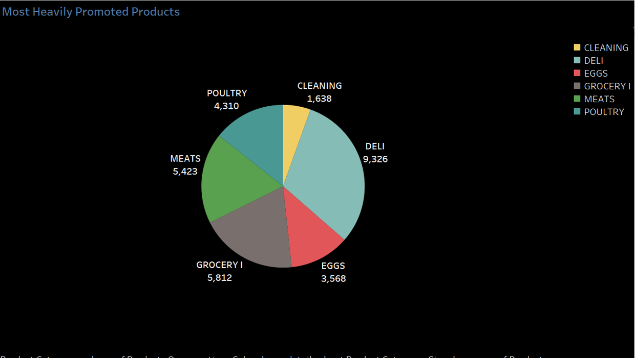
6. MOST HEAVILY PROMOTED PRODUCT CATEGORIES

Slide 9
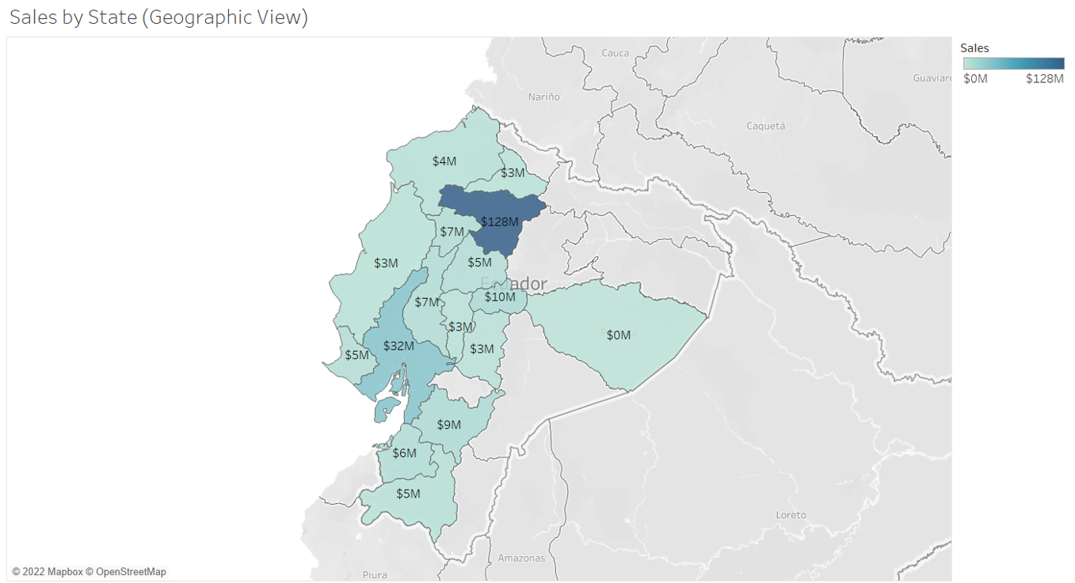
7. SALES BY STATE (GEOGRAPHIC VIEW)

Slide 10

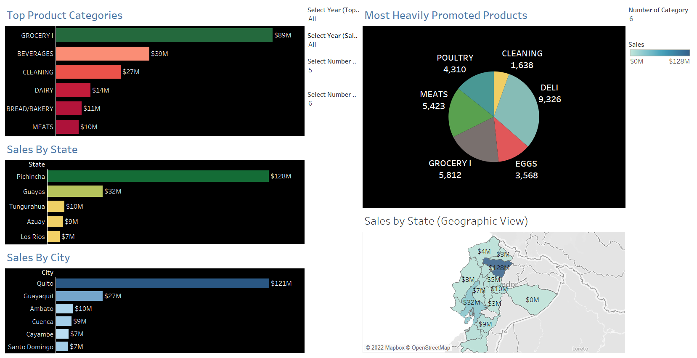
8. DASHBOARD

Slide 11
THE END

